Slide 1
M2m: Imbalanced Classification via Major-to-minor Translation Jaehyung Kim et al.，CVPR’2020
孙肖仪
2020年11月

Slide 2
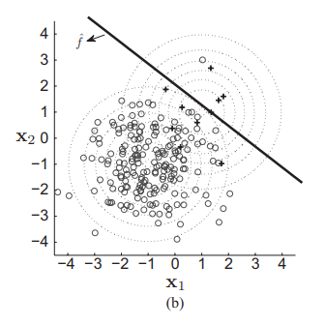
Background
Class imbalance problem
In most real-world scenarios, labeled training datasets are highly class-imbalanced
Expensive data acquisition process and the labeling cost leads a dataset to have a “long-tailed” label distribution

Slide 3
Background
Class imbalance problem
In most real-world scenarios, labeled training datasets are highly class-imbalanced
Expensive data acquisition process and the labeling cost leads a dataset to have a “long-tailed” label distribution

Slide 4
Common methods for data imbalance
Sampling Methods
Under-sampling
main idea: remove majority class samples from the data
Sample method
random under-sampling
informed under-sampling: training multiple classifiers
Over-sampling
main idea: compensate the lack of minority samples
Sample method
duplicate minority samples
generates synthetic minority samples

Slide 5

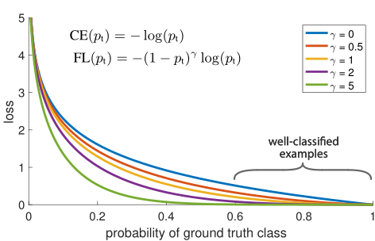


Common methods for data imbalance
Cost-Sensitive Methods
Main idea: applying different costs for different samples
Methods:
cost function formulation:
a new loss function , weigh the class objectives
Focal loss：
Directly improve F1 score loss:
and

Slide 6
Common methods for data imbalance
Ensemble Learning Methods
Main idea: utilize multiple weak classifiers
combines sampling techniques with boosting algorithm for imbalanced data classification

Slide 7
Common methods for data imbalance
key challenge
cannot handle the lack of minority information in essence
over-fitting to minority classes

Slide 8
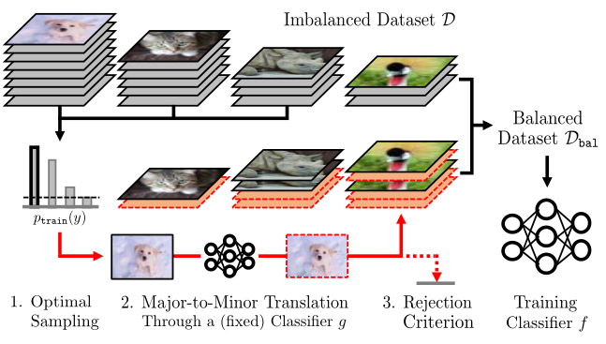
Contribution
propose a new way of generating minority samples
Different from applies data augmentation to minority samples, this work generate minority samples from majority samples
design a sample rejection criterion

Slide 9



Problem definition
K classes from a dataset
Let denote the total sample size of D, we assume N1 ≥ N2 ≥ ··· ≥ NK
assume a “virtually balanced” training dataset Dbal made from Ds
baseline classifier g is trained from Dbal
goal of the model:
g may be over-fitted to minority classes

Slide 10

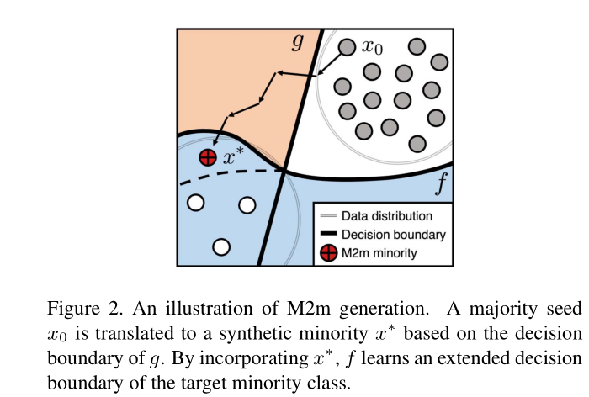
Method
The training of f:
generate new minority samples from a (relatively) major class k0<k

Slide 11

Method
Sample rejection criterion
rejecting each of the synthetic samples randomly with probability depending on k0 and k
For example, if β = 0.999, the synthetic samples are accepted with probability more than 99% if Nk0 −Nk > 4602.

Slide 12

Method
Optimal seed sampling:
how to choose a (majority) seed sample x0 with class k0
Q maximizes the acceptance probability
Q chooses diverse classes as much as possible i.e., the entropy H(Q)

Slide 13
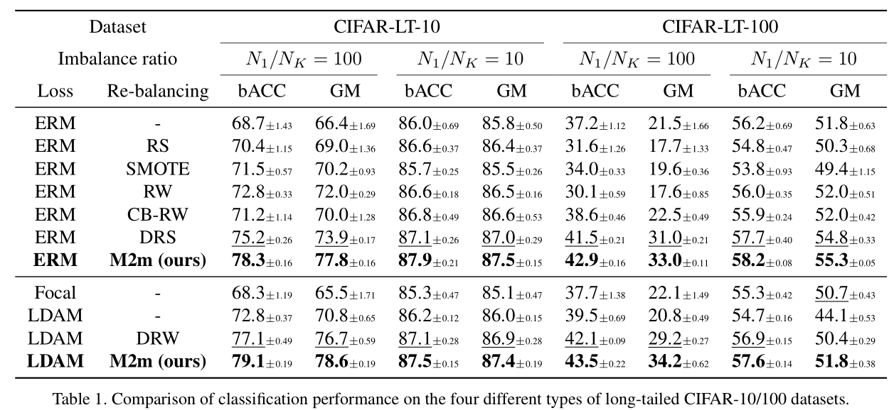
Experiments
CIFAR-LT-10/100 datasets
control the imbalance ratio ρ ∈ {100,10} and artificially reduce the training sample sizes of each class except the first class
Notes:
deferred re-weighting (DRW) [4]: re-sampling and re-weighting is deferred until the later stage of the training
SMOTE [5]: a variant of re-sampling with data augmentation
label-distribution-aware margin (LDAM) [4]: the classifier is trained to impose larger margin to minority classes
geometric mean scores (GM) [26, 3], which are defined by the arithmetic and geometric mean over class-wise sensitivity (i.e., recall)
Erm: empirical risk minimization

Slide 14
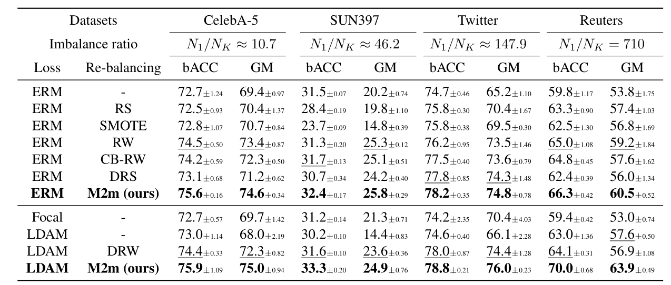
Experiments
Real-world imbalanced datasets

Slide 15
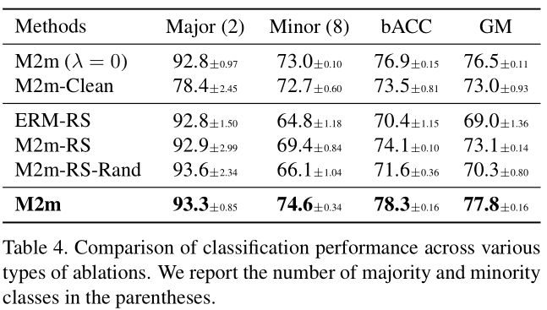
Experiments
The effect of λ

Slide 16
To conclude
Pros: translate the majority classes to the minority classes
classifier g is enough to capture the information in the small minority dataset
the sample diversity in the majority dataset is utilized to prevent over-fitting on the minority classes
Cons: why randomly rejection helps to solve the problem?
g is not that perfect: the synthetic samples still contain some discriminative features of the original class k0

